Slide 1




PROJECT
Algorithms in Computational Biology
Discovering and Analyzing DNA and protein sequence motifs
Sangam Rai- 2021196
Akash Maurya- 2021009

Slide 2
Content
What are DNA and Protein motifs?
Algorithms and programs available for motif search
MEME (Multiple EM for Motif Elicitation)
GLAM2: Gapped Local Alignment of Motifs
References

Slide 3
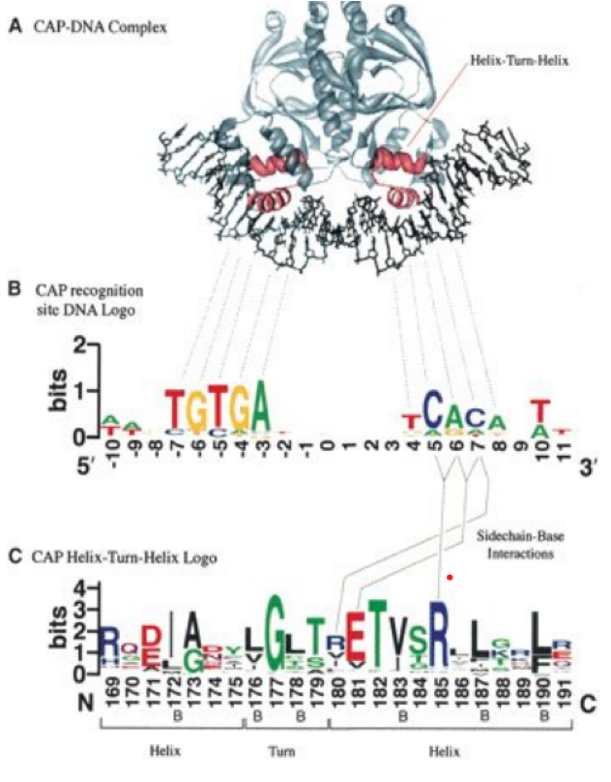
What are DNA and Protein motifs?
Motif: Conserved regions
DNA motifs and protein motifs are short, conserved sequences of nucleotides or amino acids, respectively , that are important for their functional and structural properties.
Common DNA motifs are TATA box and GC box.

Slide 4
Why Identify DNA and Protein Sequence Motifs ?
Identifying DNA and protein sequence motifs plays a crucial role in advancing our understanding of biological systems, from molecular mechanisms to disease processes, and can have significant implications for medicine, biotechnology, and beyond.
It can help in understanding of -
Functional and structural properties of proteins.
Regulation of gene expression.
Discovery of potential drug targets.

Slide 5
Algorithms and programs available for motif search
Enumeration
Enumeration algorithms exhaustively search through all possible motifs within the given sequences to identify the most common or statistically significant ones. These algorithms are simple but can be computationally expensive, especially for large datasets.
It iterates through all possible motifs of a given length within the sequences and counts their occurrences.
Examples :- MotifFinder, YMF, WEEDER

Slide 6
2. Probabilistic Optimization
Uses a Gibbs sampling approach
Iteratively refines motif models based on data. It probabilistically adjusts motif parameters to maximize the likelihood of observed sequences. This approach allows for flexible and adaptive motif discovery, capturing complex patterns effectively. Convergence is achieved when the model stabilizes, ensuring robust motif identification.
Computationally intensive but are scalable and can handle large datasets effectively.
Examples :- Gibbs Motif Sampler, MEME

Slide 7
3. Deterministic Optimization
Deterministic optimization algorithms aim to find the optimal motif(s) through systematic search or optimization techniques without relying on randomness. These algorithms are often more efficient than probabilistic approaches but may be limited in their ability to explore the solution space. It fast and scalable but may converge to suboptimal solutions.
Examples :- Greedy Motif Search

Slide 8
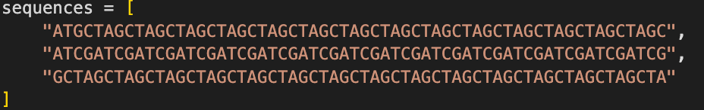
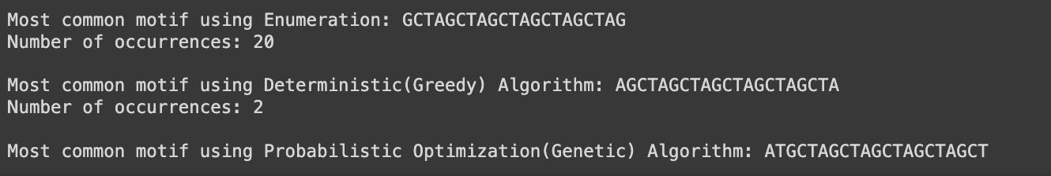
Motif found using Algorithm that we created-
Sequences-
Result-

Slide 9
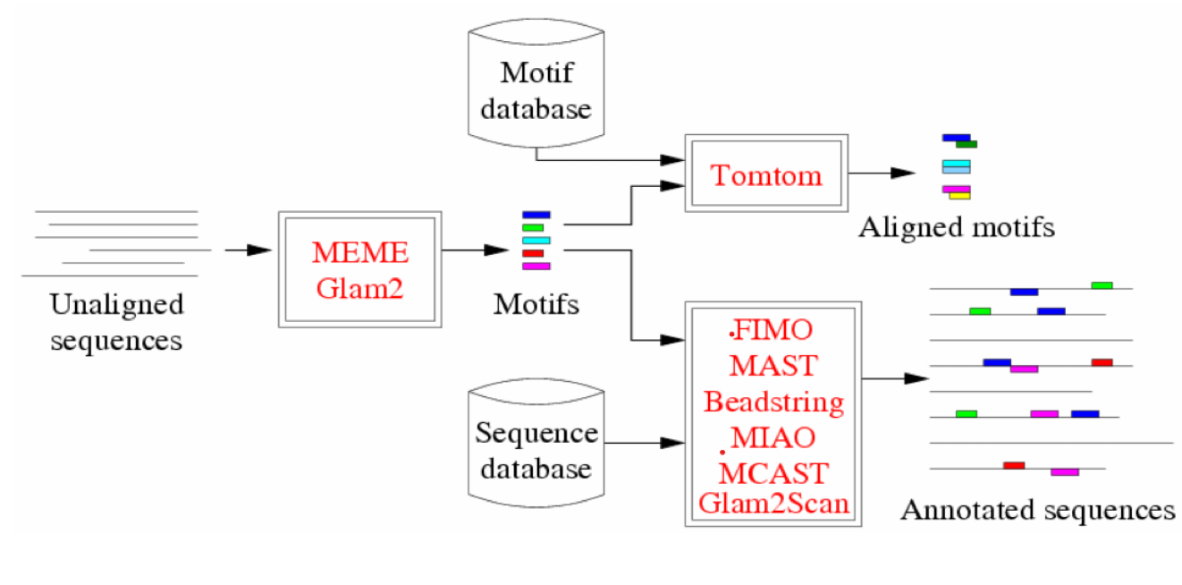
Workflow of MEME & GLAM2
Prepare Sequences, typically in FASTA format
Access MEME server
Upload and Specify Parameters
Run Motif Discovery
Analyze and Interpret Results

Slide 10
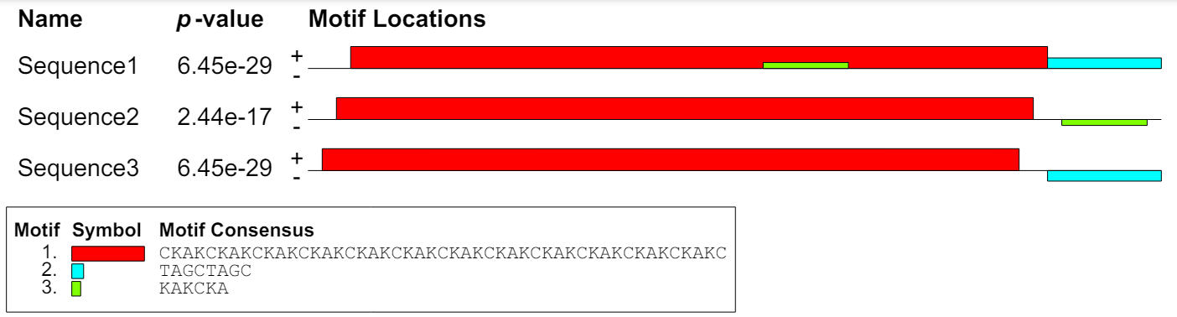
MEME (Multiple Em for Motif Elicitation) is a widely used tool for discovering motifs in DNA or protein sequences.
MEME outputs- A set of position-specific probability matrices (PSPMs) that represent the conserved sequences of the discovered motifs and a set of predicted binding sites for each motif in the input sequences.
MEME works by searching for repeated, ungapped sequence patterns that occur in the DNA or protein sequences provided by the user.
Strengths: accuracy and flexibility. Limitations: Computationally intensive

Slide 11
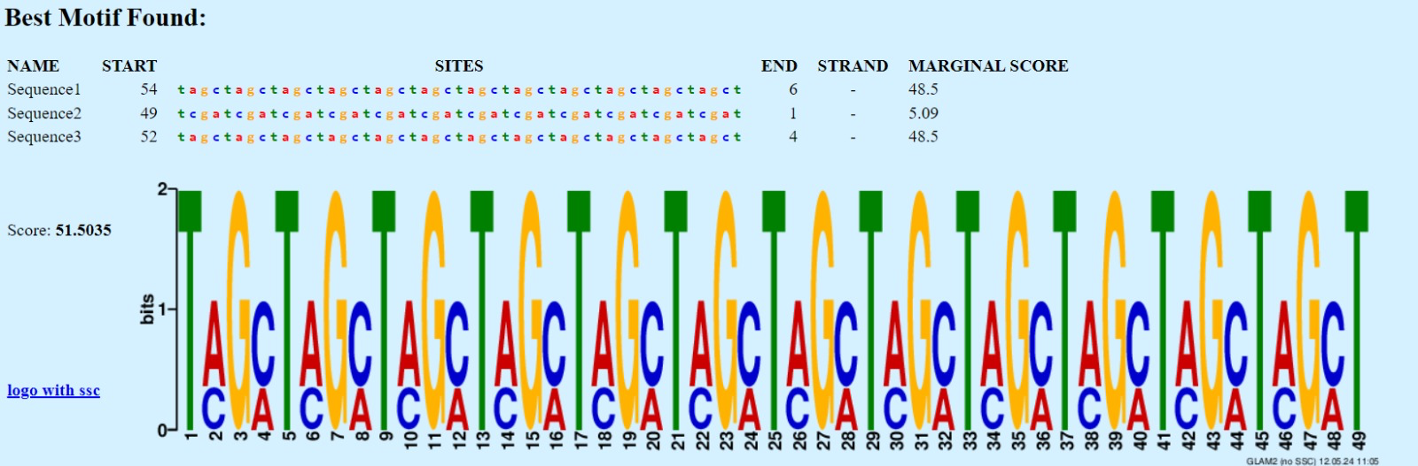
GLAM2: Gapped Local Alignment of Motifs
Uses a gapped local alignment approach to identify conserved regions within the input sequences that may represent functional motifs.
It is designed to identify conserved motifs with variable length gaps between them, making it particularly suitable for detecting motifs in non-coding DNA regions or protein sequences.
Strengths: Flexible length and structure. Limitations:Higher memory and computational

Slide 12
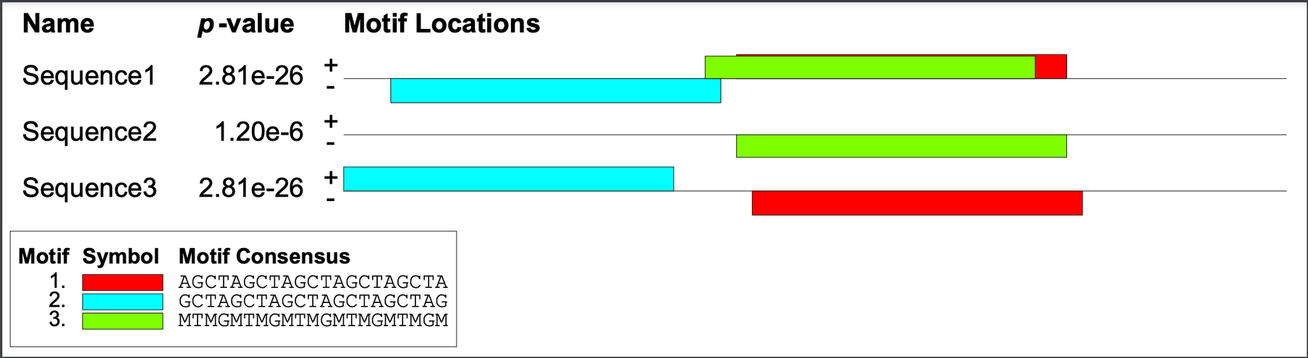
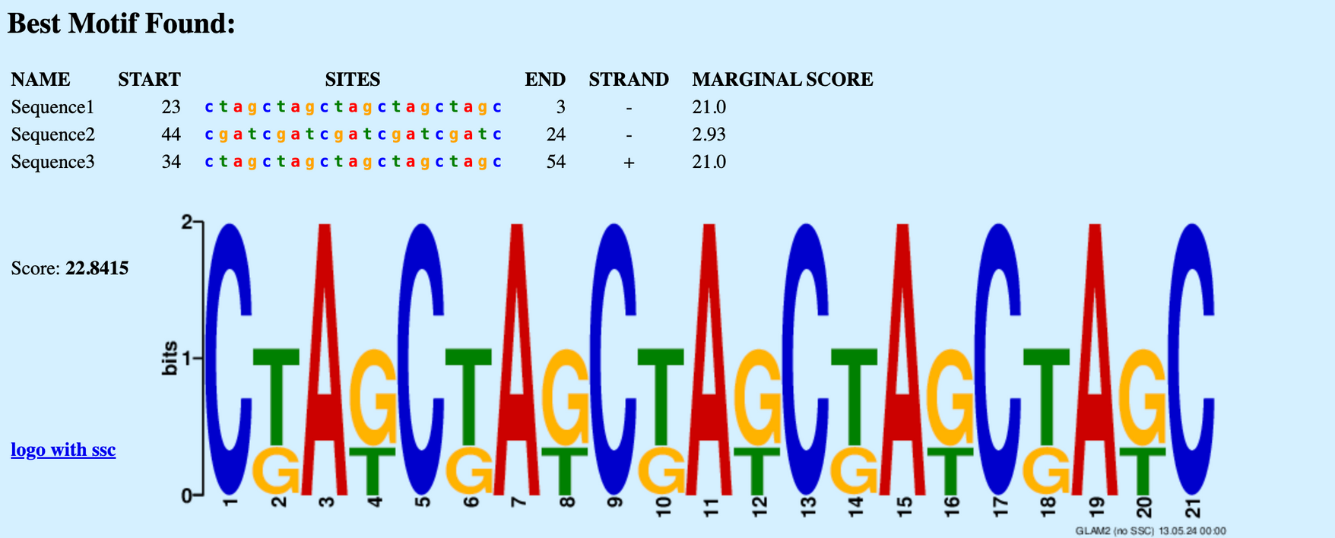

Slide 13
Applications of MEME
MEME (Multiple Em for Motif Elicitation) has numerous applications in bioinformatics and computational biology-
Analyzing the functional and structural properties of proteins
Identifying potential drug targets
Analyzing gene expression data
Application to non-coding regions such as enhancers or long non-coding RNAs, to identify regulatory elements that control gene expression.
Analyzing the evolutionary conservation of motifs
Discovering protein-protein interaction motifs

Slide 14
References
T. L. Bailey, N. Williams, C. Misleh, and W. W. Li, “MEME: discovering and analyzing DNA and protein sequence motifs,” Nucleic Acids Research, vol. 34, no. Web Server, pp. W369–W373, Jul. 2006, doi: 10.1093/nar/gkl198.
Tool link- https://meme-suite.org/meme/tools/glam2
Glam2 output link- https://meme-suite.org/meme/opal-jobs/appGLAM2_5.5.51715580461424-1789183213/glam2.html
MEME output link- https://meme-suite.org/meme//opal-jobs/appMEME_5.5.51715536554136-1750809899/meme.html
Glam2 (21)-https://meme-suite.org/meme//opal-jobs/appGLAM2_5.5.51715580461424-1789183213/glam2.html
MEME-https://meme-suite.org/meme//opal-jobs/appMEME_5.5.517155804257991311705679/meme.html
https://www.ncbi.nlm.nih.gov/pmc/articles/PMC4489269/
https://en.wikipedia.org/wiki/Expectation%E2%80%93maximization_algorithm
https://bmcbioinformatics.biomedcentral.com/articles/10.1186/1471-2105-8-S7-S21
http://halfonlab.ccr.buffalo.edu/Bioinformatics%20Primers%20from%20Nature%20Biotechnology/D'haeseleer_2006_Nat%20Biotechnol-16900144.pdf

